Slide 1
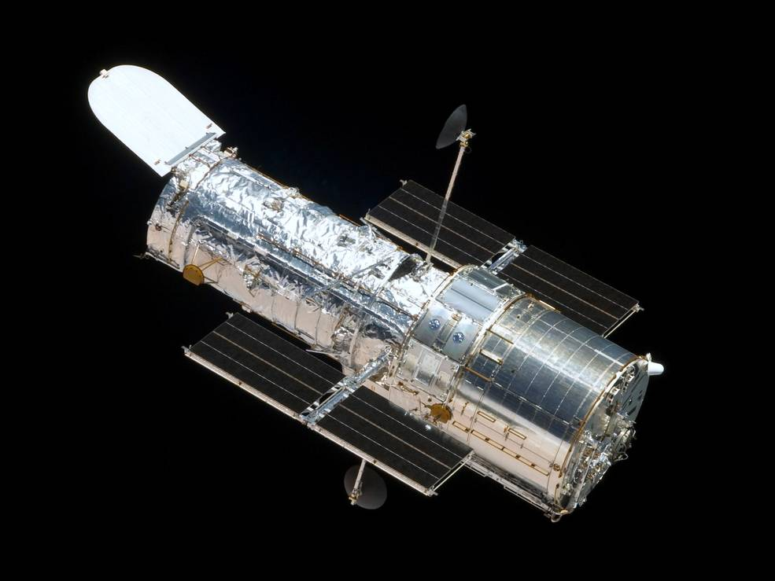
Star Track
Jacob Heglund
ABE 598
3/6/18

Slide 2
Problem Motivation
Star tracking an extremely accurate method for satellite attitude determination
The only method of consistently solving the “lost in space” problem
Current problem with star trackers? Too expensive for small missions!
Inexpensive star tracking systems at least $100,000
Costs from small tolerances in lens design + need for robustness in harsh operating conditions.

Slide 3

Example of Star Tracking Image

Slide 4
Problem Statement
Neural networks extremely effective at image recognition (Krizhevsky 2012)
Most research on neural networks trained to identify stars from the early 2000’s
Want to implement modern ML techniques to star identification
First step, apply CNN to the task of star recognition
Later, develop the system to be robust to lower quality cameras and lenses to allow for less expensive star tracking systems

Slide 5
References
Li, C., Li, K., Zhang, L., Jin, S., & Zu, J. (2003). Star pattern recognition method based on neural network. Chinese Science Bulletin, 48(18), 1927-1930.
Hong, J., & Dickerson, J. A. (2000). Neural-network-based autonomous star identification algorithm. Journal of Guidance, Control, and Dynamics, 23(4), 728-735.
Trask, A. J. (2002). Autonomous artificial neural network star tracker for spacecraft attitude determination (Doctoral dissertation).
Ho, K. (2012). A survey of algorithms for star identification with low-cost star trackers. Acta Astronautica, 73, 156-163.
Spratling, B. B., & Mortari, D. (2009). A survey on star identification algorithms. Algorithms, 2(1), 93-107.
Krizhevsky, A., Sutskever, I., & Hinton, G. E. (2012). Imagenet classification with deep convolutional neural networks. In Advances in neural information processing systems (pp. 1097-1105).

